Slide 2
LOCALITY MATTERS
Neural responses show local, but not piecewise, learning.
Enes Avcu, Ryan Rhodes, Arild Hestvik
Contact: eavcu@mgh.harvard.edu
Postdoctoral Research Fellow
Neurodynamics and Neural Decoding Group
Massachusetts General Hospital
Harvard Medical School
Notes:
Hello everyone, welcome to our talk and thank you for being here. In the next 20 minutes, I will show you some examples of how we, as learners, represent patterns, specifically the phonotactic patterns in our mind. We will also learn more about the neurophysiological markers of this learning process.
We are constantly trying to make sense of data. This is true as scientists, but it’s also true as learners. Learners are trying to find patterns in data to create a more accurate world model – to converge on a knowledge state that accurately reflects the world.
In addition, learners constantly making generalizations from data. As scientists, we are trying to reverse engineer this learning process to understand the knowledge state that the learner converges on.

Slide 3
Notes:
[animation slide]
However, this is a difficult process, because for a given set of data, there may be many possible generalizations that describe it (and many possible algorithms that can generate it).
Looking at a highly constrained world of input data – phonotactics –
The question is can we use experimental data to determine how a complex pattern is represented in the mind of the learner?
Let’s look at some phonotactic patterns

Slide 4
liŋ
∗#ŋ
ŋil
Strictly Local
Prohibited substrings
Notes:
In English, a word can end with a velar nasal (an engma), but it can’t begin with one. So a word like “ling” is perfectly acceptable, but a word like “ingil” is ungrammatical.
We can characterize this pattern as a simple prohibition – star word-edge engma. That captures the rule that English does not allow an engma immediately following a word edge.
This rule is strictly local, meaning it only applies to immediately adjacent sounds (or symbols).
The rule can be described by listing prohibited substrings –sequences of adjacent symbols.

Slide 5
∫nox∫
∗∫…s
∫noxs
Strictly Piecewise
Prohibited subsequences
Notes:
Languages like Chumash have more long-distance phonotactic patterns like Sibilant Harmony.
In Chumash, a word like shnoxsh (meaning “nose”) is perfectly acceptable, but a word like shnoxs is ungrammatical. What’s the rule here?
In Chumash, a word cannot contain both ess and esh – regardless of how far apart they are. The rule is non-local meaning it does not matter how many segments intervene between the sibilants, they still must match.
This rule can be formulated with an equally simple prohibition – star esh ess.
This rule is strictly piecewise and different from our English rule. Instead of prohibiting substrings, we are now prohibiting subsequences. Subsequences are defined only by the relative order of the segments. They do not have to be adjacent, they just have to occur in the specified order within a word.

Slide 6
recursively enumerable
context-sensitive
context-free
regular
Regular
Locally Threshold Testable
Locally Testable
Piecewise Testable
-Strictly Local-
-Strictly Piecewise-
successor
precedence
∗#ŋ
∗∫…s
Notes:
Here is where these two rules stand in the complexity hierarchy.
Both of these rules (the strictly local rule of English and the strictly piecewise rule of Chumash) fall under the Regular region of the Chomsky hierarchy.
The regular region can be subdivided into two main branches of languages – one defined by the successor relation which operates over substrings, and one defined by the precedence relation which operates over subsequences. The successor relation gives us English-like rules, and the precedence relation gives us Chumash-like rules.

Slide 7
saso
sakaso
Prohibited Substrings
sVʃ
ʃVs
Prohibited Substrings
sVCVʃ
ʃVCVs
Prohibited Subsequences
s…ʃ
ʃ…s
Notes:
Although we have two different kinds of grammars that can describe different kinds of rules, the two grammars can sometimes produce the same output.
If we take “Sibilant Harmonic” words like we see in Chumash, these can be described either as Strictly local (with prohibited substrings) or as strictly piecewise (with prohibited subsequences).
Suppose we are learning a language with long distance phonotactic rules like Chumash. If our input consists of short words like “saso”, we might generalize a strictly local rule with these prohibited substrings.
If our input consists of longer words like “sakaso”, we will need longer substrings to accurately describe the sibilant harmony pattern.
However, we might instead generalize a strictly piecewise rule with these prohibited subsequences. If we generalize to a strictly piecewise rule, in fact the same rule will be able to account for both types of input data.

Slide 8
saso
sakaso
SL-3
SP-2
SL-5
SP-2
#sa
#se
#si
#so
#su
#∫a
#∫e
#∫i
#∫o
#∫u
sas
ses
sis
sos
sus
∫a∫
∫e∫
∫i∫
∫o∫
∫u∫
as#
es#
is#
os#
us#
a∫#
e∫#
i∫#
o∫#
u∫#
s…s
s…a
s…e
s…i
s…o
s…u
∫…∫
∫…a
∫…e
∫…i
∫…o
∫…u
a…a
a…e
a…i
a…o
a…u
e…a
e…e
e…i
e…o
e…u
i…a
i…e
i…i
i…o
i…u
o…a
o…e
o…i
o…o
o…u
u…a
u…e
u…i
u…o
u…u
a…s
a…∫
e…s
e…∫
i…s
i…∫
o…s
o…∫
u…s
u…∫
#saka
#sake
#saki
#sako
#saku
#seka
#seke
#seki
#seko
#seku
#sika
#sike
#siki
#siko
#siku
#soka
#soke
#soki
#soko
#soku
#suka
#suke
#suki
#suko
#suku
#∫aka
#∫ake
#∫aki
#∫ako
#∫aku
#∫eka
#∫eke
#∫eki
#∫eko
#∫eku
#∫ika
#∫ike
#∫iki
#∫iko
#∫iku
#∫oka
#∫oke
#∫oki
#∫oko
#∫oku
#∫uka
#∫uke
#∫uki
#∫uko
#∫uku
sakas
sakes
sakis
sakos
sakus
sekas
sekes
sekis
sekos
sekus
sikas
sikes
sikis
sikos
sikus
sokas
sokes
sokis
sokos
sokus
sukas
sukes
sukis
sukos
sukus
∫aka∫
∫ake∫
∫aki∫
∫ako∫
∫aku∫
∫eka∫
∫eke∫
∫eki∫
∫eko∫
∫eku∫
∫ika∫
∫ike∫
∫iki∫
∫iko∫
∫iku∫
∫oka∫
∫oke∫
∫oki∫
∫oko∫
∫oku∫
∫uka∫
∫uke∫
∫uki∫
∫uko∫
∫uku∫
akasa
akase
akasi
akaso
akasu
akesa
akese
akesi
akeso
akesu
akisa
akise
akisi
akiso
akisu
akosa
akose
akosi
akoso
akosu
akusa
akuse
akusi
akuso
akusu
ekasa
ekase
ekasi
ekaso
ekasu
ekesa
ekese
ekesi
ekeso
ekesu
ekisa
ekise
ekisi
ekiso
ekisu
ekosa
ekose
ekosi
ekoso
ekosu
ekusa
ekuse
ekusi
ekuso
ekusu
ikasa
ikase
ikasi
ikaso
ikasu
ikesa
ikese
ikesi
ikeso
ikesu
ikisa
ikise
ikisi
ikiso
ikisu
ikosa
ikose
ikosi
ikoso
ikosu
ikusa
ikuse
ikusi
ikuso
ikusu
okasa
okase
okasi
okaso
okasu
okesa
okese
okesi
okeso
okesu
okisa
okise
okisi
okiso
okisu
okosa
okose
okosi
okoso
okosu
okusa
okuse
okusi
okuso
okusu
ukasa
ukase
ukasi
ukaso
ukasu
ukesa
ukese
ukesi
ukeso
ukesu
ukisa
ukise
ukisi
ukiso
ukisu
ukosa
ukose
ukosi
ukoso
ukosu
ukusa
ukuse
ukusi
ukuso
ukusu
aka∫a
aka∫e
aka∫i
aka∫o
aka∫u
ake∫a
ake∫e
ake∫i
ake∫o
ake∫u
aki∫a
aki∫e
aki∫i
aki∫o
aki∫u
ako∫a
ako∫e
ako∫i
ako∫o
ako∫u
aku∫a
aku∫e
aku∫i
aku∫o
aku∫u
eka∫a
eka∫e
eka∫i
eka∫o
eka∫u
eke∫a
eke∫e
eke∫i
eke∫o
eke∫u
eki∫a
eki∫e
eki∫i
eki∫o
eki∫u
eko∫a
eko∫e
eko∫i
eko∫o
eko∫u
eku∫a
eku∫e
eku∫i
eku∫o
eku∫u
ika∫a
ika∫e
ika∫i
ika∫o
ika∫u
ike∫a
ike∫e
ike∫i
ike∫o
ike∫u
iki∫a
iki∫e
iki∫i
iki∫o
iki∫u
iko∫a
iko∫e
iko∫i
iko∫o
iko∫u
iku∫a
iku∫e
iku∫i
iku∫o
iku∫u
oka∫a
oka∫e
oka∫i
oka∫o
oka∫u
oke∫a
oke∫e
oke∫i
oke∫o
oke∫u
oki∫a
oki∫e
oki∫i
oki∫o
oki∫u
oko∫a
oko∫e
oko∫i
oko∫o
oko∫u
oku∫a
oku∫e
oku∫i
oku∫o
oku∫u
uka∫a
uka∫e
uka∫i
uka∫o
uka∫u
uke∫a
uke∫e
uke∫i
uke∫o
uke∫u
uki∫a
uki∫e
uki∫i
uki∫o
uki∫u
uko∫a
uko∫e
uko∫i
uko∫o
uko∫u
uku∫a
uku∫e
uku∫i
uku∫o
uku∫u
kasa#
kase#
kasi#
kaso#
kasu#
kesa#
kese#
kesi#
keso#
kesu#
kisa#
kise#
kisi#
kiso#
kisu#
kosa#
kose#
kosi#
koso#
kosu#
kusa#
kuse#
kusi#
kuso#
kusu#
ka∫a#
ka∫e#
ka∫i#
ka∫o#
ka∫u#
ke∫a#
ke∫e#
ke∫i#
ke∫o#
ke∫u#
ki∫a#
ki∫e#
ki∫i#
ki∫o#
ki∫u#
ko∫a#
ko∫e#
ko∫i#
ko∫o#
ko∫u#
ku∫a#
ku∫e#
ku∫i#
ku∫o#
ku∫u#
s…s
s…a
s…e
s…i
s…o
s…u
∫…∫
∫…a
∫…e
∫…i
∫…o
∫…u
a…a
a…e
a…i
a…o
a…u
e…a
e…e
e…i
e…o
e…u
i…a
i…e
i…i
i…o
i…u
o…a
o…e
o…i
o…o
o…u
u…a
u…e
u…i
u…o
u…u
a…s
a…∫
e…s
e…∫
i…s
i…∫
o…s
o…∫
u…s
u…∫
s…k
∫…k
a…k
e…k
i…k
o…k
u…k
k…s
k…∫
k…a
k…e
k…i
k…o
k…u
30
47
400
61
Notes:
Now let’s see how the learning process entails. Let’s put ourselves inside the mind of a learner. We are presented with a bunch of words and what we need to do is to come up with a rule!
How do we figure out the rule? We need to keep track of all the possible strings, then using the process of elimination, we will postulate the prohibited substrings/subsequences.
However, listing all the possible substrings scales dramatically up when the word length is increased. Here is a demo of how the hypothesis space of SL grammars explode and reach a level where we can not track of possible strings anymore.
So the idea is that for a short word, SL grammar might be better place to start but for a long word it is not a good place to start!

Slide 9
How are long distance phonotactic patterns represented in the mind of the learner?
Notes:
So our question is: How are long distance phonotactic patterns actually being represented in the mind of a naïve learner?
We assume learning cause some kind of physical change in the brain, therefore we examine this learning both at the behavioral and neural level with EEG.

Slide 10
saso
sakaso
N = 24
N = 20
CV.CV
C: [s, ʃ ] V: [a,ɛ,ɔ,i,u]
saso, ʃuʃi, seʃa, ʃisu
CV.CV.CV
C: [s, ʃ ,k] V: [a,ɛ,ɔ,i,u]
sakiso, ʃukeʃi, sekoʃa, ʃikasu
Word duration: 400 ms
Violation point: 200 ms
Word duration: 650 ms
Violation point: 450 ms
SL3 or SP2
SL5 or SP2
Notes:
To answer this question, we exposed learners in the lab to sibilant harmonic stimuli in an artificial grammar learning paradigm. In the training phase, they listened and repeat words that follow the pattern and in test phase, they were asked to categorize words as good and bad words. No feedback is given neither in training nor in test to make it as natural as possible.
One group was exposed to short words like “saso”, and the other group was exposed to longer words like “sakaso”. The words are very simple and the hypothesis space is very constrained. We have use two sibilants and 5 vowels plus k for the longer words in the alphabet.
Make sure that short words can be described as either SL-3 (prohibited substrings with length 3) or SP-2 (prohibited subsequences with length 2)
Long words can be described as either SL-5 (prohibited substrings with length 5) or SP-2

Slide 11
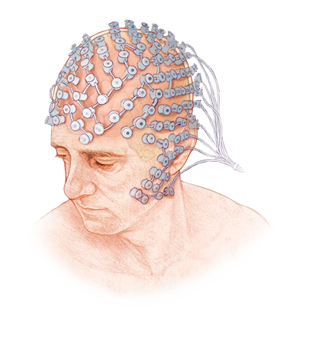
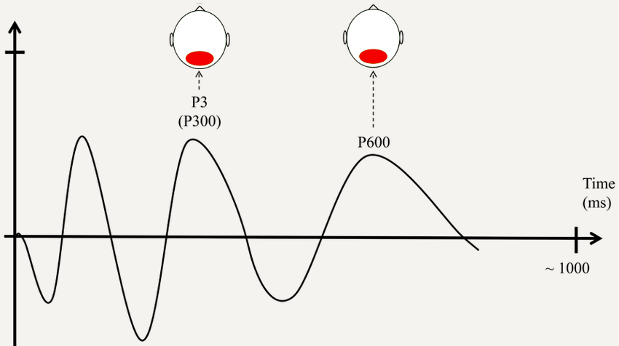
Sensitivity
d-prime
P300
categorization
LPC
anomaly detection
SL hypothesis: learning will be easier for saso than sakaso.
SP hypothesis: no differences between groups.
Notes:
Now let’s talk about the hypotheses and predictions. At the behavioral level, we measured learning with D’ prime: Thus, higher and positive d’ means learning happened. At the neural level, we will look for P3 – to index categorization difference between harmonic and disharmonic words. We expect to observe P3 300ms after violation point. We also look for LPC – to index anomaly detection in disharmonic words. We expect to observe it 600ms after violation point.
For the current dataset, there are two possible grammars that the learners can converge on: SL and SP. SL is a useful strategy for short words, while SP is a better strategy for longer words.
If they go with the SL grammar for both patterns, it is predicted that there will be a difference between the two groups. A difference in d’, and a difference in P3 or LPC amplitude or the time course of the neural response.
If they go with the SP grammar, there will no difference between the groups.

Slide 12
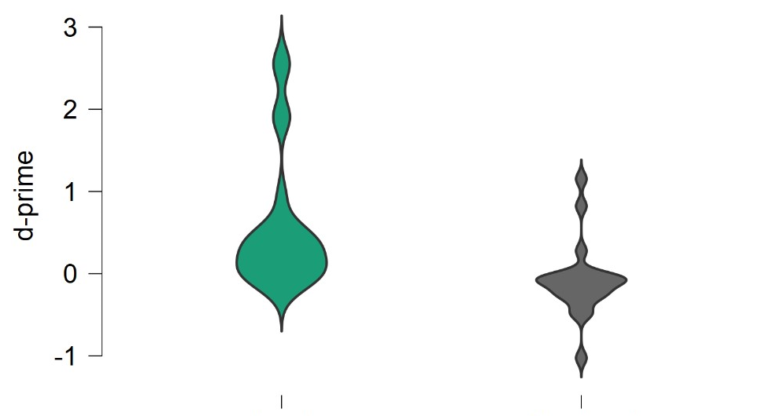
d'
saso
sakaso
Group difference: t(42) = 3.13, p = .003, 1-β = .863.
Notes:
Here are the d’ results:
The orange lines represent the means.
While the saso group showed significant d’ , sakaso group’s d’ is not significantly different from zero and actually the mean is around zero.
Although there was a significant group difference, the sakaso group did not learn the pattern.
The fact that subjects didn't learn the rule from the long words shows that they were converging on an SL grammar.
Let’s look at the neural results.

Slide 13
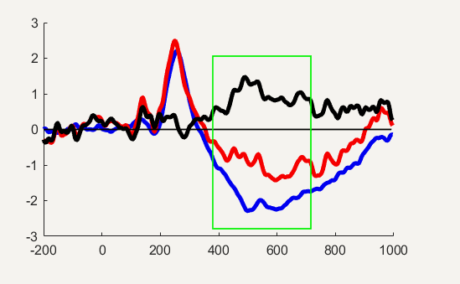
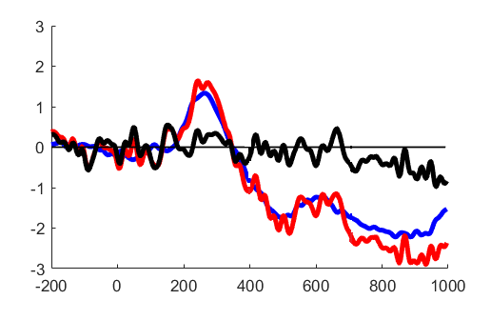
P3
Cz
Cz
saso
sakaso
Notes:
Here is the first part of the neural results:
On the left you see the saso group, Blue waveform represent harmonic stimuli, red disharmonic and black is the difference wave form. Right after the offset of the word, the 400 ms, the blue and red here started to diverge, and this difference peaks at 500 ms which is exactly 300 ms after the violation point. Here is the topographic distribution of this response: a fronto central positivity. So we have our P3.
On the right, we see the same waveform graph for the sakaso group, the difference between blue and red is not significant, therefore the black wave is bouncing around zero. Here is the topographic distribution.
So we have a significant neural response for the short words which is following the behavioral results.

Slide 14
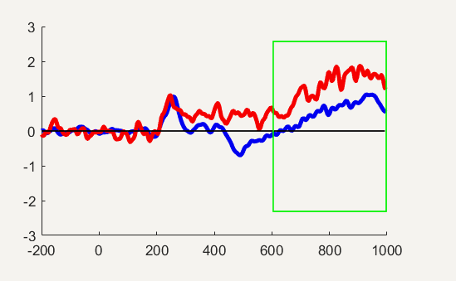
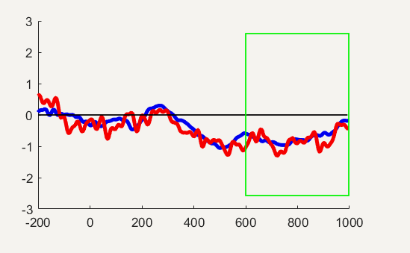
LPC
Pz
Pz
saso
sakaso
Notes:
In the second part of the neural results, we will look for the LPC effect.
On the left, in the late time window, disharmonic words elicited more positivity than the harmonic words. This is a typical syntax like P600 response where the ungrammatical stimuli elicited more positivity. The peak of the response is around 800 ms which is 600 ms after the violation point. And here is the topographic distribution of this response: nice parietal positivity.
On the right, again no difference between blue and red, therefore no LPC which is reflected in the topo map too.

Slide 15
saso
sakaso
Why didn’t the sakaso group learn the rule?
SL3 or SP2
SL5 or SP2
L1 effect
Hypothesis space
Working memory capacity
Simplicity bias
Notes:
These results showed that our participants learned the rule when words were short, but failed to learn when the words were long. But why did the learners in the second group really failed?
The first reason might relate to the L1 effect. Specifically, the learners did not prefer to represent these patterns at the peicewise level due to the fact that English does not have a vowel or consonant harmony kind of long distance patten. Therefore, they go with the local rule.
Secondly, we saw that increasing the word length boost up the hypothesis space for SL grammars. While keeping track of all the possible adjacent substrings work for the short words, for longer words it does not work.
Thirdly, our learners started with the local dependency rule and it was OK for them to keep 3 adjacent strings in their working memory but when it comes to keep 5 things in the memory, they could not do that.
The last point I want to discuss is about the simplicity bias. There is a simplicity bias when generalizing from the ambiguous data. Our patterns here were ambiguous in the sense that the data can be explained by two different grammars. And it seems when pattern is ambiguous, learners prefer SL, which is why they failed in the longer word.

Slide 16
saso
sakaso
Learners attempted to generalize a strictly local rule…
…even for longer words.
Why didn’t the sakaso group learn the rule?
SL3 or SP2
SL5 or SP2
Notes:
To sum up, our learners attempted to generalize a strictly local rule, even when this led them astray and prevented them from converging on the correct grammar.
This reminds me of an old joke – A man on one side of a river shouts to a farmer standing on the other side, “Hey, how do I get to the town on the other side of the river?”. The farmer tells him several paths to town but all of them starts on the other side of the river. The man asks, that’s fine, but how do I get there from here? And the farmer says, well, I wouldn’t start from there.
So, How do we converge on the correct grammar for long distance patterns? If our starting point assumes locality, well, maybe we shouldn’t start from there!

Slide 17
Last Slide

Slide 18
saso
sakaso
Learners attempted to generalize a strictly local rule…
…even for longer words.
SL3 or SP2
SL5 or SP2
Notes:
So how are long distance phonotactic patterns represented in the mind of the learner?
Participants learned the rule when words were short, but failed to learn the rule when words were long.
But Why did the learners in the second group fail?
The first reason relates to the L1 effect. Specifically, the learners did not want to represent these patterns at the piecewise level maybe because English does not have a long distance pattern.
Learners start with the local dependency rule and when they need to keep 5 things in their memory, they cannot do that.
The learners did not want to represent these patterns at the piecewise level, maybe because English does not have vowel or sibilant harmony kind of long-distance patterns.

Slide 19
saso
sakaso
SL3 or SP2
SL5 or SP2
Learners assume SL
*sVʃ or * ʃVs
*sVkVʃ or * ʃVkVs
Why not SP?
*s..ʃ or *ʃ..s
L1 effect of English
One more speculation point?
Notes:
Summarize results
Speculate:
Learners start with the local dependency rule and when they need to keep 5 things in their memory, they cannot do that.
Computationally complex patterns require more time and memory for learning to happen.
The learners did not want to represent these patterns at the piecewise level, maybe because English does not have vowel or sibilant harmony kind of long-distance patterns.

Slide 20
Prohibited Subsequences
s…ʃ
ʃ…s
saso
sakaso
Prohibited Substrings
sVʃ
ʃVs
Prohibited Substrings
sVCVʃ
ʃVCVs
Notes:
Illustration of SH pattern described as SL and as SP
Full list of prohibited substrings and subsequences

